Slide 1
String Array and Pointers
Saif Nalband

Slide 2
Pointers
A pointer is a variable that stores a memory address.
Because there is no pass-by-reference in C like in C++, pointers let us pass around the address of one instance of memory, instead of making many copies.
One (8 byte) pointer can represent any size memory location!
Pointers are also essential for allocating memory on the heap, which we will cover later.
Pointers also let us refer to memory generically, which we will cover later.

Slide 3
Memory
Memory is a big array of bytes.
Each byte has a unique numeric index that is commonly written in hexadecimal.
A pointer stores one of these memory addresses.
Address | Value
 | …
0x105 | '\0'
0x104 | 'e'
0x103 | 'l'
0x102 | 'p'
0x101 | 'p'
0x100 | 'a'
 | …

Slide 4
Pointers
int x = 2;
// Make a pointer that stores the address of x.
// (& means "address of")
int *xPtr = &x;
// Dereference the pointer to go to that address.
// (* means "dereference")
printf("%d", *xPtr); // prints 2
If declaration: “pointer” ex: int * is "pointer to an int”
If operation: "dereference/the value at address” ex: *num is "the value at address num"
*

Slide 5
Pointers
A pointer is a variable that stores a memory address.
void myFunc(int *intPtr) {
*intPtr = 3;
}
int main(int argc, char *argv[]) {
int x = 2;
myFunc(&x);
printf("%d", x); // 3!
...
}

Slide 6
Pointers
STACK
A pointer is a variable that stores a memory address.
void myFunc(int *intPtr) {
*intPtr = 3;
}
int main(int argc, char *argv[]) {
int x = 2;
myFunc(&x);
printf("%d", x); // 3!
...
}
main

Slide 7
Pointers
STACK
A pointer is a variable that stores a memory address.
void myFunc(int *intPtr) {
*intPtr = 3;
}
int main(int argc, char *argv[]) {
int x = 2;
myFunc(&x);
printf("%d", x); // 3!
...
}
main
x
2

Slide 8
Pointers
STACK
A pointer is a variable that stores a memory address.
void myFunc(int *intPtr) {
*intPtr = 3;
}
int main(int argc, char *argv[]) {
int x = 2;
myFunc(&x);
printf("%d", x); // 3!
...
}
main
x
2
myFunc
intPtr

Slide 9
Pointers
STACK
A pointer is a variable that stores a memory address.
void myFunc(int *intPtr) {
*intPtr = 3;
}
int main(int argc, char *argv[]) {
int x = 2;
myFunc(&x);
printf("%d", x); // 3!
...
}
main
x
2
myFunc
intPtr

Slide 10
Pointers
STACK
A pointer is a variable that stores a memory address.
void myFunc(int *intPtr) {
*intPtr = 3;
}
int main(int argc, char *argv[]) {
int x = 2;
myFunc(&x);
printf("%d", x); // 3!
...
}
main
x
3
myFunc
intPtr

Slide 11
Pointers
STACK
A pointer is a variable that stores a memory address.
void myFunc(int *intPtr) {
*intPtr = 3;
}
int main(int argc, char *argv[]) {
int x = 2;
myFunc(&x);
printf("%d", x); // 3!
...
}
main
x
3

Slide 12
Pointers
STACK
A pointer is a variable that stores a memory address.
void myFunc(int *intPtr) {
*intPtr = 3;
}
int main(int argc, char *argv[]) {
int x = 2;
myFunc(&x);
printf("%d", x); // 3!
...
}
main
x
3

Slide 13
Pointers
A pointer is a variable that stores a memory address.
void myFunc(int *intPtr) {
*intPtr = 3;
}
int main(int argc, char *argv[]) {
int x = 2;
myFunc(&x);
printf("%d", x); // 3!
...
}
STACK
Address | Value
 | …
0x1f0 | 2
 | …
x
main()

Slide 14
Pointers
A pointer is a variable that stores a memory address.
void myFunc(int *intPtr) {
*intPtr = 3;
}
int main(int argc, char *argv[]) {
int x = 2;
myFunc(&x);
printf("%d", x); // 3!
...
}
STACK
Address | Value
 | …
0x1f0 | 2
 | …
x
main()

Slide 15
Pointers
A pointer is a variable that stores a memory address.
void myFunc(int *intPtr) {
*intPtr = 3;
}
int main(int argc, char *argv[]) {
int x = 2;
myFunc(&x);
printf("%d", x); // 3!
...
}
STACK
Address | Value
 | …
0x1f0 | 2
 | …
0x10 | 0x1f0
 | …
x
main()
myFunc()
intPtr

Slide 16
Pointers
A pointer is a variable that stores a memory address.
void myFunc(int *intPtr) {
*intPtr = 3;
}
int main(int argc, char *argv[]) {
int x = 2;
myFunc(&x);
printf("%d", x); // 3!
...
}
STACK
Address | Value
 | …
0x1f0 | 2
 | …
0x10 | 0x1f0
 | …
x
main()
myFunc()
intPtr

Slide 17
Pointers
A pointer is a variable that stores a memory address.
void myFunc(int *intPtr) {
*intPtr = 3;
}
int main(int argc, char *argv[]) {
int x = 2;
myFunc(&x);
printf("%d", x); // 3!
...
}
STACK
Address | Value
 | …
0x1f0 | 3
 | …
0x10 | 0x1f0
 | …
x
main()
myFunc()
intPtr

Slide 18
Pointers
A pointer is a variable that stores a memory address.
void myFunc(int *intPtr) {
*intPtr = 3;
}
int main(int argc, char *argv[]) {
int x = 2;
myFunc(&x);
printf("%d", x); // 3!
...
}
STACK
Address | Value
 | …
0x1f0 | 3
 | …
x
main()

Slide 19
Pointers
A pointer is a variable that stores a memory address.
void myFunc(int *intPtr) {
*intPtr = 3;
}
int main(int argc, char *argv[]) {
int x = 2;
myFunc(&x);
printf("%d", x); // 3!
...
}
STACK
Address | Value
 | …
0x1f0 | 3
 | …
x
main()

Slide 20
Pointers
Without pointers, we would make copies.
void myFunc(int val) {
val = 3;
}
int main(int argc, char *argv[]) {
int x = 2;
myFunc(x);
printf("%d", x); // 2!
...
}
STACK
Address | Value
 | …
0x1f0 | 2
 | …
x
main()

Slide 21
Pointers
Without pointers, we would make copies.
void myFunc(int val) {
val = 3;
}
int main(int argc, char *argv[]) {
int x = 2;
myFunc(x);
printf("%d", x); // 2!
...
}
STACK
Address | Value
 | …
0x1f0 | 2
 | …
x
main()

Slide 22
Pointers
Without pointers, we would make copies.
void myFunc(int val) {
val = 3;
}
int main(int argc, char *argv[]) {
int x = 2;
myFunc(x);
printf("%d", x); // 2!
...
}
STACK
Address | Value
 | …
0x1f0 | 2
 | …
0x10 | 2
 | …
x
main()
myFunc()
val

Slide 23
Pointers
Without pointers, we would make copies.
void myFunc(int val) {
val = 3;
}
int main(int argc, char *argv[]) {
int x = 2;
myFunc(x);
printf("%d", x); // 2!
...
}
STACK
Address | Value
 | …
0x1f0 | 2
 | …
0x10 | 2
 | …
x
main()
myFunc()
val

Slide 24
Pointers
Without pointers, we would make copies.
void myFunc(int val) {
val = 3;
}
int main(int argc, char *argv[]) {
int x = 2;
myFunc(x);
printf("%d", x); // 2!
...
}
STACK
Address | Value
 | …
0x1f0 | 2
 | …
0x10 | 3
 | …
x
main()
myFunc()
val

Slide 25
Pointers
Without pointers, we would make copies.
void myFunc(int val) {
val = 3;
}
int main(int argc, char *argv[]) {
int x = 2;
myFunc(x);
printf("%d", x); // 2!
...
}
STACK
Address | Value
 | …
0x1f0 | 2
 | …
x
main()

Slide 26
Pointers
Without pointers, we would make copies.
void myFunc(int val) {
val = 3;
}
int main(int argc, char *argv[]) {
int x = 2;
myFunc(x);
printf("%d", x); // 2!
...
}
STACK
Address | Value
 | …
0x1f0 | 2
 | …
x
main()

Slide 27
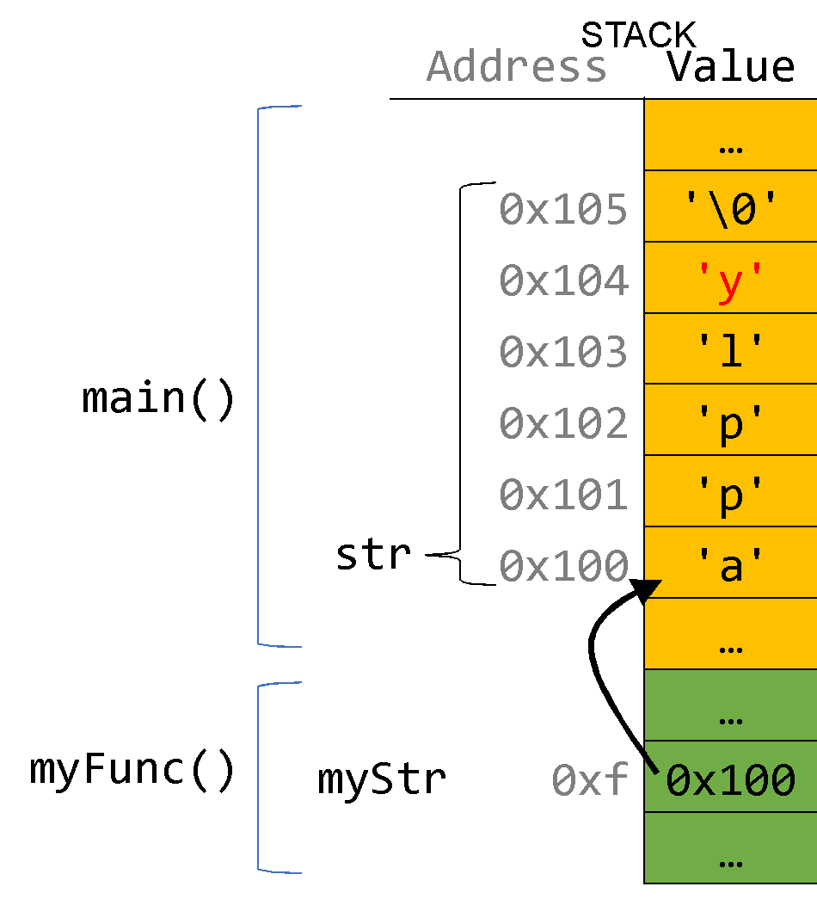
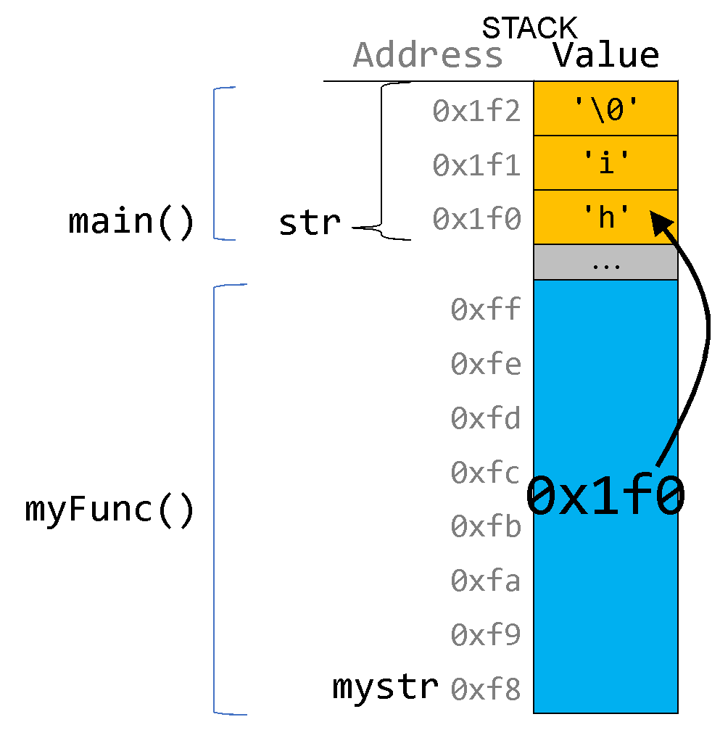
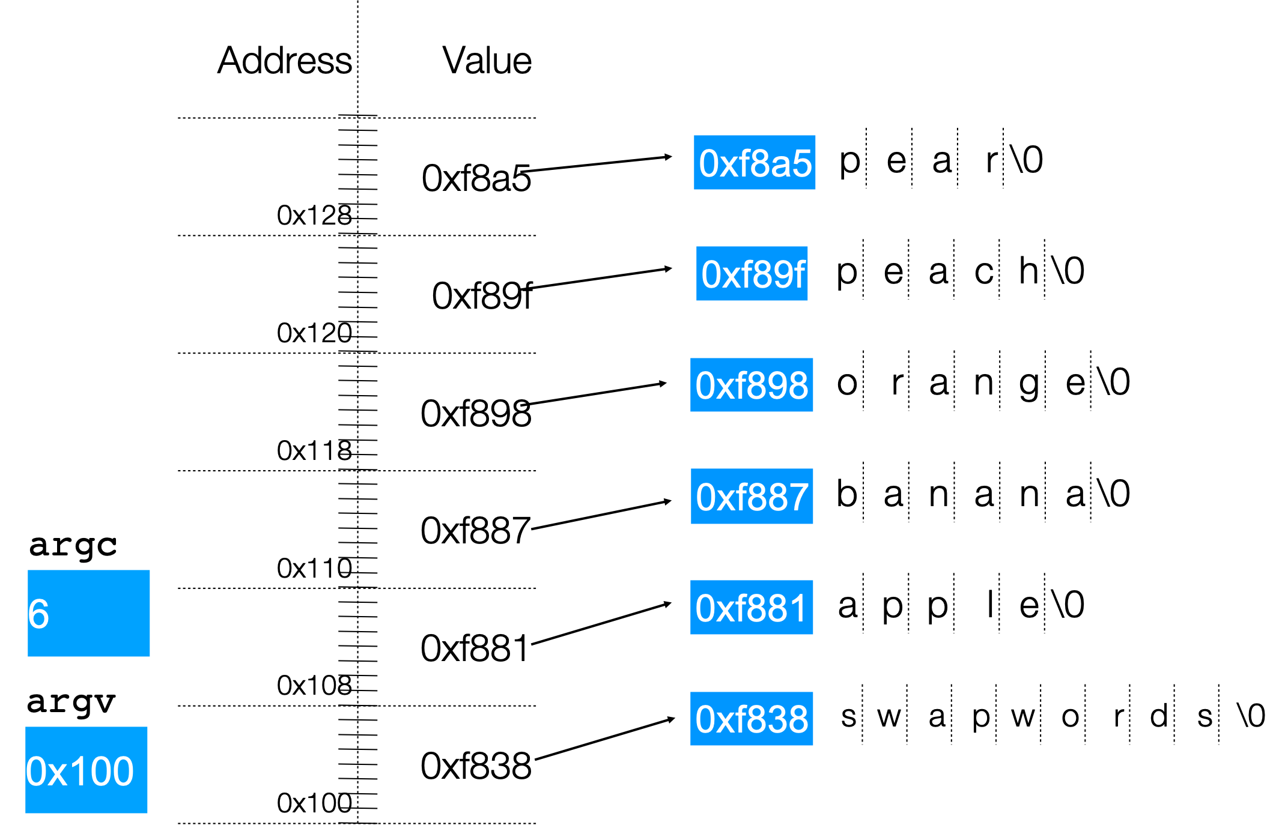
How to draw memory diagrams?
Choose whatever style is convenient for you, keeping in mind that (1) memory is contiguous, and (2) C types are different sizes.

Slide 28
C Parameters
When you pass a value as a parameter, C passes a copy of that value.
void myFunction(int x) {
…
}
int main(int argc, char *argv[]) {
int num = 4;
myFunction(num); // passes copy of 4
}

Slide 29
C Parameters
When you pass a value as a parameter, C passes a copy of that value.
void myFunction(int *x) {
…
}
int main(int argc, char *argv[]) {
int num = 4;
myFunction(&num); // passes copy of e.g. 0xffed63
}

Slide 30
C Parameters
When you pass a value as a parameter, C passes a copy of that value.
void myFunction(char ch) {
…
}
int main(int argc, char *argv[]) {
char *myStr = "Hello!";
myFunction(myStr[1]); // passes copy of 'e'
}

Slide 31
C Parameters
If you are performing an operation with some input and do not care about any changes to the input, pass the data type itself.

Slide 32
C Parameters
If you are performing an operation with some input and do not care about any changes to the input, pass the data type itself.
void myFunction(char ch) {
printf("%c", ch);
}
int main(int argc, char *argv[]) {
char *myStr = "Hello!";
myFunction(myStr[1]); // prints 'e'
}

Slide 33
C Parameters
If you are performing an operation with some input and do not care about any changes to the input, pass the data type itself.
int myFunction(int num1, int num2) {
return num1 + num2;
}
int main(int argc, char *argv[]) {
int x = 5;
int y = 6;
int sum = myFunction(x, y); // returns 11
}

Slide 34
C Parameters
If you are modifying a specific instance of some value, pass the location of what you would like to modify.
Do I care about modifying this instance of my data? If so, I need to pass where that instance lives, as a parameter, so it can be modified.

Slide 35
Pointers
If you are modifying a specific instance of some value, pass the location of what you would like to modify.
void capitalize(char *ch) {
// modifies what is at the address stored in ch
}
int main(int argc, char *argv[]) {
char letter = 'h';
/* We don’t want to capitalize any instance of 'h'.
* We want to capitalize *this* instance of 'h'! */
capitalize(&letter);
printf("%c", letter); // want to print 'H';
}

Slide 36
Pointers
If you are modifying a specific instance of some value, pass the location of what you would like to modify.
void doubleNum(int *x) {
// modifies what is at the address stored in x
}
int main(int argc, char *argv[]) {
int num = 2;
/* We don’t want to double any instance of 2.
* We want to double *this* instance of 2! */
doubleNum(&num);
printf("%d", num); // want to print 4;
}

Slide 37
Pointers
If a function takes an address (pointer) as a parameter, it can go to that address if it needs the actual value.
void capitalize(char *ch) {
// *ch gets the character stored at address ch.
char newChar = toupper(*ch);
// *ch = goes to address ch and puts newChar there.
*ch = newChar;
}

Slide 38
Pointers
If a function takes an address (pointer) as a parameter, it can go to that address if it needs the actual value.
void capitalize(char *ch) {
/* go to address ch and put the capitalized version
* of what is at address ch there. */
*ch = toupper(*ch);
}

Slide 39
Pointers
If a function takes an address (pointer) as a parameter, it can go to that address if it needs the actual value.
void capitalize(char *ch) {
// this capitalizes the address ch! ☹
char newChar = toupper(ch);
// this stores newChar in ch as an address! ☹
ch = newChar;
}

Slide 40
Strings in Memory

Slide 41
char *
A char * is technically a pointer to a single character.
We commonly use char * as string by having the character it points to be followed by more characters and ultimately a null terminator.
A char * could also just point to a single character (not a string).

Slide 42
Strings In Memory
If we create a string as a char[], we can modify its characters because its memory lives in our stack space.
We cannot set a char[] equal to another value, because it is not a pointer; it refers to the block of memory reserved for the original array.
If we pass a char[] as a parameter, set something equal to it, or perform arithmetic with it, it’s automatically converted to a char *.
If we create a new string with new characters as a char *, we cannot modify its characters because its memory lives in the data segment.
We can set a char * equal to another value, because it is a reassign-able pointer.
Adding an offset to a C string gives us a substring that many places past the first character.
If we change characters in a string parameter, these changes will persist outside of the function.

Slide 43
String Behavior #1: If we create a string as a char[], we can modify its characters because its memory lives in our stack space.

Slide 44
Character Arrays
When we declare an array of characters, contiguous memory is allocated on the stack to store the contents of the entire array. We can modify what is on the stack.
char str[6];
strcpy(str, "apple");
STACK
Address | Value
 | …
0x105 | '\0'
0x104 | 'e'
0x103 | 'l'
0x102 | 'p'
0x101 | 'p'
0x100 | 'a'
 | …
str

Slide 45
String Behavior #2: We cannot set a char[] equal to another value, because it is not a pointer; it refers to the block of memory reserved for the original array.

Slide 46
Character Arrays
An array variable refers to an entire block of memory. We cannot reassign an existing array to be equal to a new array.
char str[6];
strcpy(str, "apple");
char str2[8];
strcpy(str2, "apple 2");
str = str2; // not allowed!
An array’s size cannot be changed once we create it; we must create another new array instead.

Slide 47
String Behavior #3: If we pass a char[] as a parameter, set something equal to it, or perform arithmetic with it, it’s automatically converted to a char *.

Slide 48
String Parameters
How do you think the parameter str is being represented?
void fun_times(char *str) {
...
}
int main(int argc, char *argv[]) {
char local_str[5];
strcpy(local_str, "rice");
fun_times(local_str);
return 0;
}
?
str
0xa0 | 0xa1 | 0xa2 | 0xa3 | 0xa4
'r' | 'i' | 'c' | 'e' | '\0'
local_str
A copy of the array local_str
A pointer containing an address to the first element in local_str
🤔
Notes:
The “professional programmer language.”
Takeaway #2: An string name is the address of the first element.

Slide 49
String Parameters
How do you think the parameter str is being represented?
void fun_times(char *str) {
...
}
int main(int argc, char *argv[]) {
char local_str[5];
strcpy(local_str, "rice");
fun_times(local_str);
return 0;
}
str
0xa0
0xa0 | 0xa1 | 0xa2 | 0xa3 | 0xa4
'r' | 'i' | 'c' | 'e' | '\0'
local_str
A copy of the array local_str
A pointer containing an address to the first element in local_str
Notes:
The “professional programmer language.”
Takeaway #2: An string name is the address of the first element.

Slide 50
char * Variables
How do you think the local variable str is being represented?
int main(int argc, char *argv[]) {
char local_str[5];
strcpy(local_str, "rice");
char *str = local_str;
...
return 0;
}
?
str
0xa0 | 0xa1 | 0xa2 | 0xa3 | 0xa4
'r' | 'i' | 'c' | 'e' | '\0'
local_str
A copy of the array local_str
A pointer containing an address to the first element in local_str
🤔
Notes:
The “professional programmer language.”
Takeaway #2: An string name is the address of the first element.

Slide 51
char * Variables
How do you think the local variable str is being represented?
int main(int argc, char *argv[]) {
char local_str[5];
strcpy(local_str, "rice");
char *str = local_str;
...
return 0;
}
str
0xa0
0xa0 | 0xa1 | 0xa2 | 0xa3 | 0xa4
'r' | 'i' | 'c' | 'e' | '\0'
local_str
A copy of the array local_str
A pointer containing an address to the first element in local_str
Notes:
The “professional programmer language.”
Takeaway #2: An string name is the address of the first element.

Slide 52
char * Variables
How do you think the local variable str is being represented?
int main(int argc, char *argv[]) {
char local_str[5];
strcpy(local_str, "rice");
char *str = local_str + 2;
...
return 0;
}
?
str
0xa0 | 0xa1 | 0xa2 | 0xa3 | 0xa4
'r' | 'i' | 'c' | 'e' | '\0'
local_str
A copy of part of the array local_str
A pointer containing an address to the third element in local_str
🤔
Notes:
The “professional programmer language.”
Takeaway #2: An string name is the address of the first element.

Slide 53
char * Variables
How do you think the local variable str is being represented?
int main(int argc, char *argv[]) {
char local_str[5];
strcpy(local_str, "rice");
char *str = local_str + 2;
...
return 0;
}
str
0xa2
0xa0 | 0xa1 | 0xa2 | 0xa3 | 0xa4
'r' | 'i' | 'c' | 'e' | '\0'
local_str
A copy of part of the array local_str
A pointer containing an address to the third element in local_str
Notes:
The “professional programmer language.”
Takeaway #2: An string name is the address of the first element.

Slide 54
String Parameters
All string functions take char * parameters – they accept char[], but they are implicitly converted to char * before being passed.
strlen(char *str)
strcmp(char *str1, char *str2)
…
char * is still a string in all the core ways a char[] is
Access/modify characters using bracket notation
Print it out
Use string functions
But under the hood they are represented differently!
Takeaway: We create strings as char[], pass them around as char *

Slide 55
String Behavior #4: If we create a new string with new characters as a char *, we cannot modify its characters because its memory lives in the data segment.

Slide 56
char *
There is another convenient way to create a string if we do not need to modify it later. We can create a char * and set it directly equal to a string literal.
char *myString = "Hello, world!";
char *empty = "";
myString[0] = 'h'; // crashes!
printf("%s", myString); // Hello, world!

Slide 57
char *
When we declare a char pointer equal to a string literal, the characters are not stored on the stack. Instead, they are stored in a special area of memory called the “data segment”. We cannot modify memory in this segment.
char *str = "hi";
The pointer variable (e.g. str) refers to the address of the first character of the string in the data segment.
Address | Value
 | …
0xff0 | 0x10
 | …
 | …
0x12 | '\0'
0x11 | 'i'
0x10 | 'h'
 | …
STACK
str
DATA SEGMENT
This applies only to creating new strings with char *. This does not apply for making a char * that points to an existing stack string.
Notes:
Text segment stores string literals to potentially reduce duplicate memory

Slide 58
String Declaration
String literals are stored on the read-only memory part of most compilers. Hence they cannot be modified.
With character arrays, we can perform the usual operations on arrays including modification.
Pointers that point to the string literal cannot be modified, just like string literals.

Slide 59
Memory Locations
For each code snippet below, can we modify the characters in myStr?
char myStr[6];
Key Question: where do its characters live? Do they live in memory we own? Or the read-only data segment?

Slide 60
Memory Locations
For each code snippet below, can we modify the characters in myStr?
char *myStr = "Hi";
Key Question: where do its characters live? Do they live in memory we own? Or the read-only data segment?

Slide 61
Memory Locations
For each code snippet below, can we modify the characters in myStr?
Key Question: where do its characters live? Do they live in memory we own? Or the read-only data segment?
char buf[6];
strcpy(buf, "Hi");
char *myStr = buf;

Slide 62
Memory Locations
For each code snippet below, can we modify the characters in myStr?
char *otherStr = "Hi";
char *myStr = otherStr;
Key Question: where do its characters live? Do they live in memory we own? Or the read-only data segment?

Slide 63
Memory Locations
Q: Is there a way to check in code whether a string’s characters are modifiable?
A: No. This is something you can only tell by looking at the code itself and how the string was created.
Q: So then if I am writing a string function that modifies a string, how can I tell if the string passed in is modifiable?
A: You can’t! This is something you instead state as an assumption in your function documentation. If someone calls your function with a read-only string, it will crash, but that’s not your function’s fault :-)

Slide 64
String Behavior #5: We can set a char * equal to another value, because it is a reassign-able pointer.

Slide 65
char *
A char * variable refers to a single character. We can reassign an existing char * pointer to be equal to another char * pointer.
char *str = "apple"; // e.g. 0xfff0
char *str2 = "apple 2"; // e.g. 0xfe0
str = str2; // ok! Both store address 0xfe0

Slide 66
Arrays and Pointers
STACK
We can also make a pointer equal to an array; it will point to the first element in that array.
int main(int argc, char *argv[]) {
char str[6];
strcpy(str, "apple");
char *ptr = str;
...
}
Address | Value
 | …
0x105 | '\0'
0x104 | 'e'
0x103 | 'l'
0x102 | 'p'
0x101 | 'p'
0x100 | 'a'
0xf8 | 0x100
 | …
main()
str
ptr

Slide 67
Arrays and Pointers
STACK
We can also make a pointer equal to an array; it will point to the first element in that array.
int main(int argc, char *argv[]) {
char str[6];
strcpy(str, "apple");
char *ptr = str;
// equivalent
char *ptr = &str[0];
// confusingly equivalent, avoid
char *ptr = &str;
...
}
Address | Value
 | …
0x105 | '\0'
0x104 | 'e'
0x103 | 'l'
0x102 | 'p'
0x101 | 'p'
0x100 | 'a'
0xf8 | 0x100
 | …
main()
str
ptr

Slide 68
String Behavior #6: Adding an offset to a C string gives us a substring that many places past the first character.

Slide 69
Pointer Arithmetic
When we do pointer arithmetic, we are adjusting the pointer by a certain number of places (e.g. characters).
char *str = "apple"; // e.g. 0xff0
char *str2 = str + 1; // e.g. 0xff1
char *str3 = str + 3; // e.g. 0xff3
printf("%s", str); // apple
printf("%s", str2); // pple
printf("%s", str3); // le
TEXT SEGMENT
Address | Value
 | …
0xff5 | '\0'
0xff4 | 'e'
0xff3 | 'l'
0xff2 | 'p'
0xff1 | 'p'
0xff0 | 'a'
 | …

Slide 70
char *
When we use bracket notation with a pointer, we are performing pointer arithmetic and dereferencing:
char *str = "apple"; // e.g. 0xff0
// both of these add three places to str,
// and then dereference to get the char there.
// E.g. get memory at 0xff3.
char thirdLetter = str[3]; // 'l'
char thirdLetter = *(str + 3); // 'l'
TEXT SEGMENT
Address | Value
 | …
0xff5 | '\0'
0xff4 | 'e'
0xff3 | 'l'
0xff2 | 'p'
0xff1 | 'p'
0xff0 | 'a'
 | …

Slide 71
String Behavior #7: If we change characters in a string parameter, these changes will persist outside of the function.

Slide 72
Strings as Parameters
When we pass a char * string as a parameter, C makes a copy of the address stored in the char * and passes it to the function. This means they both refer to the same memory location.
void myFunc(char *myStr) {
...
}
int main(int argc, char *argv[]) {
char *str = "apple";
myFunc(str);
...
}
STACK
Address | Value
 | …
0xfff0 | 0x10
 | …
 | …
0xff0 | 0x10
 | …
main()
str
myFunc()
myStr

Slide 73
Strings as Parameters
STACK
When we pass a char array as a parameter, C makes a copy of the address of the first array element and passes it (as a char *) to the function.
void myFunc(char *myStr) {
...
}
int main(int argc, char *argv[]) {
char str[6];
strcpy(str, "apple");
myFunc(str);
...
}
Address | Value
 | …
0x105 | '\0'
0x104 | 'e'
0x103 | 'l'
0x102 | 'p'
0x101 | 'p'
0x100 | 'a'
 | …
 | …
0xf | 0x100
 | …
main()
str
myFunc()
myStr

Slide 74
Strings as Parameters
STACK
When we pass a char array as a parameter, C makes a copy of the address of the first array element and passes it (as a char *) to the function.
void myFunc(char *myStr) {
...
}
int main(int argc, char *argv[]) {
char str[6];
strcpy(str, "apple");
// equivalent
char *strAlt = str;
myFunc(strAlt);
...
Address | Value
 | …
0x105 | '\0'
0x104 | 'e'
0x103 | 'l'
0x102 | 'p'
0x101 | 'p'
0x100 | 'a'
 | …
 | …
0xf | 0x100
 | …
main()
str
myFunc()
myStr

Slide 75
Strings as Parameters
STACK
This means if we modify characters in myFunc, the changes will persist back in main!
void myFunc(char *myStr) {
myStr[4] = 'y';
}
int main(int argc, char *argv[]) {
char str[6];
strcpy(str, "apple");
myFunc(str);
printf("%s", str); // apply
...
}
Address | Value
 | …
0x105 | '\0'
0x104 | 'e'
0x103 | 'l'
0x102 | 'p'
0x101 | 'p'
0x100 | 'a'
 | …
 | …
0xf | 0x100
 | …
main()
str
myFunc()
myStr

Slide 76
Strings as Parameters
STACK
This means if we modify characters in myFunc, the changes will persist back in main!
void myFunc(char *myStr) {
myStr[4] = 'y';
}
int main(int argc, char *argv[]) {
char str[6];
strcpy(str, "apple");
myFunc(str);
printf("%s", str); // apply
...
}
Address | Value
 | …
0x105 | '\0'
0x104 | 'y'
0x103 | 'l'
0x102 | 'p'
0x101 | 'p'
0x100 | 'a'
 | …
 | …
0xf | 0x100
 | …
main()
str
myFunc()
myStr

Slide 77
Strings In Memory
If we create a string as a char[], we can modify its characters because its memory lives in our stack space.
We cannot set a char[] equal to another value, because it is not a pointer; it refers to the block of memory reserved for the original array.
If we pass a char[] as a parameter, set something equal to it, or perform arithmetic with it, it’s automatically converted to a char *.
If we create a new string with new characters as a char *, we cannot modify its characters because its memory lives in the data segment.
We can set a char * equal to another value, because it is a reassign-able pointer.
Adding an offset to a C string gives us a substring that many places past the first character.
If we change characters in a string parameter, these changes will persist outside of the function.

Slide 78
Arrays vs. Pointers
When you create an array, you are making space for each element in the array.
When you create a pointer, you are making space for an 4/8 byte address.
Arrays ”decay to pointers” when you perform arithmetic or pass as parameters.
&arr does nothing on arrays, but &ptr on pointers gets its address
sizeof(arr) gets the size of an array in bytes, but sizeof(ptr) is always 4/8

Slide 79
Pointers Summary
If you are performing an operation with some input and do not care about any changes to the input, pass the data type itself.
If you are modifying a specific instance of some value, pass the location of what you would like to modify.
If a function takes an address (pointer) as a parameter, it can go to that address if it needs the actual value.

Slide 80
Pointers Summary
Tip: setting a function parameter equal to a new value usually doesn’t do what you want. Remember that this is setting the function’s own copy of the parameter equal to some new value.
void doubleNum(int x) {
x = x * x; // modifies doubleNum’s own copy!
}
void advanceStr(char *str) {
str += 2; // modifies advanceStr’s own copy!
}

Slide 81
Pointers to Strings
Address | Value
 | …
 | …
void skipSpaces(char **strPtr) {
int numSpaces = strspn(*strPtr, " ");
*strPtr += numSpaces;
}
int main(int argc, char *argv[]) {
char *myStr = " hi";
skipSpaces(&myStr);
printf("%s\n", myStr); // hi
return 0;
}
STACK
main()

Slide 82
Pointers to Strings
Address | Value
 | …
0x105 | 0xf
 | …
 | …
0x13 | '\0'
0x12 | 'i'
0x11 | 'h'
0x10 | ' '
0xf | ' '
 | …
void skipSpaces(char **strPtr) {
int numSpaces = strspn(*strPtr, " ");
*strPtr += numSpaces;
}
int main(int argc, char *argv[]) {
char *myStr = " hi";
skipSpaces(&myStr);
printf("%s\n", myStr); // hi
return 0;
}
STACK
main()
myStr
DATA SEGMENT

Slide 83
Pointers to Strings
Address | Value
 | …
0x105 | 0xf
 | …
 | …
0x13 | '\0'
0x12 | 'i'
0x11 | 'h'
0x10 | ' '
0xf | ' '
 | …
void skipSpaces(char **strPtr) {
int numSpaces = strspn(*strPtr, " ");
*strPtr += numSpaces;
}
int main(int argc, char *argv[]) {
char *myStr = " hi";
skipSpaces(&myStr);
printf("%s\n", myStr); // hi
return 0;
}
STACK
main()
myStr
DATA SEGMENT

Slide 84
Pointers to Strings
Address | Value
 | …
0x105 | 0xf
 | …
 | …
0xf0 | 0x105
 | …
 | …
0x13 | '\0'
0x12 | 'i'
0x11 | 'h'
0x10 | ' '
0xf | ' '
 | …
void skipSpaces(char **strPtr) {
int numSpaces = strspn(*strPtr, " ");
*strPtr += numSpaces;
}
int main(int argc, char *argv[]) {
char *myStr = " hi";
skipSpaces(&myStr);
printf("%s\n", myStr); // hi
return 0;
}
main()
myStr
STACK
skipSpaces()
strPtr
DATA SEGMENT

Slide 85
Pointers to Strings
Address | Value
 | …
0x105 | 0xf
 | …
 | …
0xf0 | 0x105
0xe8 | 2
 | …
 | …
0x13 | '\0'
0x12 | 'i'
0x11 | 'h'
0x10 | ' '
0xf | ' '
 | …
void skipSpaces(char **strPtr) {
int numSpaces = strspn(*strPtr, " ");
*strPtr += numSpaces;
}
int main(int argc, char *argv[]) {
char *myStr = " hi";
skipSpaces(&myStr);
printf("%s\n", myStr); // hi
return 0;
}
main()
myStr
STACK
strPtr
skipSpaces()
numSpaces
DATA SEGMENT

Slide 86
Pointers to Strings
Address | Value
 | …
0x105 | 0xf
 | …
 | …
0xf0 | 0x105
0xe8 | 2
 | …
 | …
0x13 | '\0'
0x12 | 'i'
0x11 | 'h'
0x10 | ' '
0xf | ' '
 | …
void skipSpaces(char **strPtr) {
int numSpaces = strspn(*strPtr, " ");
*strPtr += numSpaces;
}
int main(int argc, char *argv[]) {
char *myStr = " hi";
skipSpaces(&myStr);
printf("%s\n", myStr); // hi
return 0;
}
main()
myStr
STACK
strPtr
skipSpaces()
numSpaces
DATA SEGMENT

Slide 87
Pointers to Strings
Address | Value
 | …
0x105 | 0x11
 | …
 | …
0xf0 | 0x105
0xe8 | 2
 | …
 | …
0x13 | '\0'
0x12 | 'i'
0x11 | 'h'
0x10 | ' '
0xf | ' '
 | …
void skipSpaces(char **strPtr) {
int numSpaces = strspn(*strPtr, " ");
*strPtr += numSpaces;
}
int main(int argc, char *argv[]) {
char *myStr = " hi";
skipSpaces(&myStr);
printf("%s\n", myStr); // hi
return 0;
}
main()
myStr
STACK
strPtr
skipSpaces()
numSpaces
DATA SEGMENT
Notes:
strPtr
*strPtr
**strPtr
&myStr
myStr

Slide 88
Pointers to Strings
Address | Value
 | …
0x105 | 0x11
 | …
 | …
0x13 | '\0'
0x12 | 'i'
0x11 | 'h'
0x10 | ' '
0xf | ' '
 | …
void skipSpaces(char **strPtr) {
int numSpaces = strspn(*strPtr, " ");
*strPtr += numSpaces;
}
int main(int argc, char *argv[]) {
char *myStr = " hi";
skipSpaces(&myStr);
printf("%s\n", myStr); // hi
return 0;
}
STACK
main()
myStr
DATA SEGMENT

Slide 89
Pointers to Strings
Address | Value
 | …
0x105 | 0x11
 | …
 | …
0x13 | '\0'
0x12 | 'i'
0x11 | 'h'
0x10 | ' '
0xf | ' '
 | …
void skipSpaces(char **strPtr) {
int numSpaces = strspn(*strPtr, " ");
*strPtr += numSpaces;
}
int main(int argc, char *argv[]) {
char *myStr = " hi";
skipSpaces(&myStr);
printf("%s\n", myStr); // hi
return 0;
}
STACK
main()
myStr
DATA SEGMENT
Weird thought – 0x11 is a string.

Slide 90
Making Copies
Address | Value
 | …
0x105 | 0xf
 | …
 | …
0xf0 | 0xf
 | …
 | …
0x13 | '\0'
0x12 | 'i'
0x11 | 'h'
0x10 | ' '
0xf | ' '
 | …
void skipSpaces(char *strPtr) {
int numSpaces = strspn(strPtr, " ");
strPtr += numSpaces;
}
int main(int argc, char *argv[]) {
char *myStr = " hi";
skipSpaces(myStr);
printf("%s\n", myStr); // hi
return 0;
}
main()
myStr
STACK
skipSpaces()
strPtr
DATA SEGMENT

Slide 91
Conclusion
Strings in C are declared with character arrays, a linear sequence of characters.
The compiler automatically appends the Null character (\0) at the end of character arrays.
There are four ways of initializing a string.
Strings in C do not support the assignment operation once declared.
Strings in C can be read using scanf(); however, it only reads until it encounters whitespace.
The combination of fgets() and puts() tacked the problem of reading a line of text with spaces.

Slide 92
Conclusion
A string can be passed to a function as a character array or in the form of a pointer.
Since character arrays act like pointers, we can easily use pointers to manipulate strings.
We can modify character arrays; however, it is impossible to do so with pointers pointing to string literals.

